Slide 1
Managing Application Config and Secrets

Slide 2
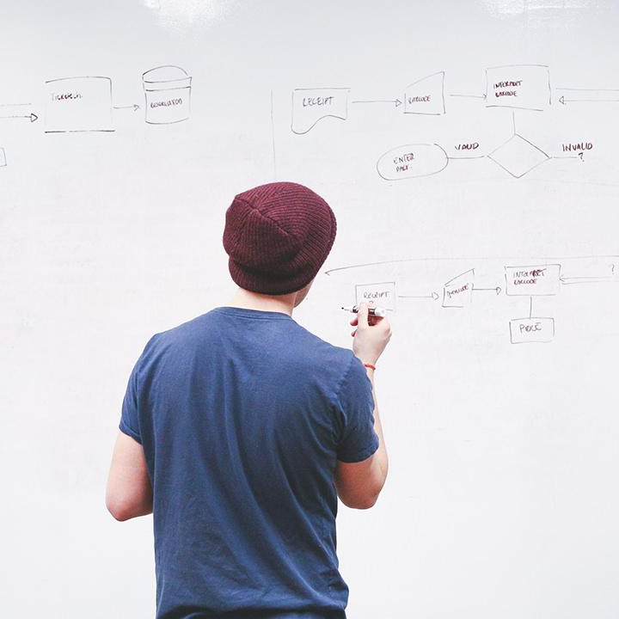
HELLO!
I am Eng Teong Cheah
Microsoft MVP
You can find me at @walkercet

Slide 3
Introduction to Security
1

Slide 4
Introduction to Security
Security is everyone’s responsibility and needs to be looked at holistically across the application life cycle.

Slide 5
SQL Injection Attack
SQL Injection (SQLi) is a type of an injection attack that makes it possible to execute malicious SQL statements.

Slide 6
Implement Secure & Compliant Development Processes
2

Slide 7
Threat Modeling
Define security requirements
Create an application diagram
Identify threats
Mitigate threats
Validate that threats have been mitigated

Slide 8
Key Validation Points
Continuous security validation should be added at each step from development through production

Slide 9
Continuous Integration
The CI build should be executed as part of the pull request (PR-CI) process and once the merge is complete
Be sure to scan third party packages for vulnerabilities and check OSS license usage

Slide 10
Infrastructure Vulnerabilities
Be sure to validate the infrastructure
Use the Azure Security Center and Azure Policies

Slide 11
Application Deployment to DEV and TEST
OWASP ZAP can be used for penetration testing
Testing can be active or passive
Conduct a quick baseline scan to identify vulnerabilities
Conduct nightly more intensive scans

Slide 12
Results and Bugs
OWASP ZAP provides a report with results and bugs
Use a holistic and layered approach to security

Slide 13
Rethinking Application Config Data
3

Slide 14
Rethinking Application Config Data
Configuration information is stored in files
Changes can require downtime and administrative overhead
Challenging to mange changes to local configurations across multiple running instance of the applications

Slide 15
Separation of Concerns
Configuration Custodian
Configuration Consumer
Configuration Store
Secret Store

Slide 16
External Configuration Store Patterns
Store the configuration in external storage
Provide an interface to quickly and efficiently read and update

Slide 17
Integrating Azure Key Vault with Azure Pipeline
Allows you to manage your organization’s secrets and certificates in a centralized repository

Slide 18
Manage Secrets, Tokens, and Certificates
4

Slide 19
Manage Secrets, Tokens & Certificates
Centralize application secrets
Security store secrets and keys
Monitor access and use
Simplified administration of application secret
Integrate with other Azure services

Slide 20
Kubernetes and Azure Key Vault
Use Kubernetes and Azure Key Vault together to get the best security benefits:
Azure Key Vault Secret store
Kubernetes ConfigMaps
Kubernets Secrets

Slide 21
Implement Tools for Managing Security and Compliance
5

Slide 22
SonarCloud
Technical debt – measure between the codebase’s current state and an optimal state
SonarQube

Slide 23
Implement Continuous Security Validation
Reduce cost by moving DevSecOps to the left Use automated tooling and processes to identify problems

Slide 24
THANKS!
Any questions?
You can find me at
@walkercet

Slide 25
CREDITS
Microsoft Docs

